Slide 1

Class 18: Degree Correlations
Assortativity and hierarchy
Prof. Boleslaw Szymanski
Prof. Albert-László Barabási
Dr. Baruch Barzel, Dr. Mauro Martino
Network Science: Degree Correlations 2015

Slide 2
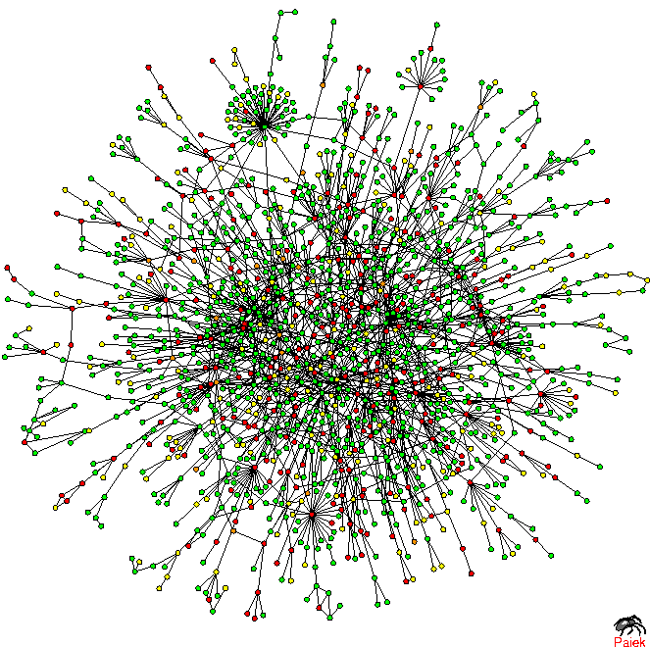
Prot P(k)
TOPOLOGY OF THE PROTEIN NETWORK
Nodes: proteins
Links: physical interactions (binding)
Puzzling pattern:
Hubs tend to link to small degree nodes.
Why is this puzzling?
In a random network, the probability that a node with degree k links to a node with degree k’ is:
k≅50, k’=13, N=1,458, L=1746
Yet, we see many links between degree 2 and 1 links, and no links between the hubs.
H. Jeong, S.P. Mason, A.-L. Barabasi, Z.N. Oltvai, Nature 411, 41-42 (2001)
Network Science: Degree Correlations 2015

Slide 3
DEGREE CORRELATIONS IN NETWORKS
Assortative:
hubs show a tendency to link to each other.
Neutral:
nodes connect to each other with the expected random probabilities.
Disassortative:
Hubs tend to avoid linking to each other.
Quantifying degree correlations (three approaches):
→ full statistical description (Maslov and Sneppen, Science 2001)
→ degree correlation function (Pastor Satorras and Vespignani, PRL 2001)
→ correlation coefficient (Newman, PRL 2002)
Network Science: Degree Correlations 2015

Slide 4
STATISTICAL DESCRIPTION
e_{jk}: probability to find a node with degree j and degree k at the two ends of a randomly selected edge
q_{k}: the probability to have a degree k node at the end of a link.
Where:
Probability to find a node at the end of a link is biased towards the more connected nodes, i.e. q_{k}=Ckp_{k,} where C is a normalization constant . After normalization we find C=1/<k>, or q_{k}=kp_{k}/<k>
If the network has no degree correlations:
Deviations from this prediction are a signature of degree correlation.
M. E. J. Newman, Phys. Rev. Lett. 89, 208701 (2002)
Network Science: Degree Correlations 2015

Slide 5
EXAMPLE: e_{jk} FOR A SCALE-FREE NETWORK
Assortative:
More strength in the diagonal, hubs tend to link to each other.
Neutral
Disassortative:
Hubs tend to connect to small nodes.
Each matrix is the average of a 100 independent scale-free networks, generated using the static model with N=10⁴, γ=2.5 and <k>=3.
Network Science: Degree Correlations 2015

Slide 6
EXAMPLE: e_{jk} FOR A SCALE-FREE NETWORK
Assortative:
More strength in the diagonal, hubs tend to link to each other.
Perfectly assortative network:
e_{jk}=q_{k}δ_{jk}
Disassortative:
Hubs tend to connect to small nodes.
Perfectly disassortative network:
Each matrix is the average of a 100 independent scale-free networks, generated using the static model with N=10⁴, γ=2.5 and <k>=3.
Network Science: Degree Correlations 2015

Slide 7
REAL-WORLD EXAMPLES
Astrophysics co-authorship network
Yeast PPI
Assortative:
More strength in the diagonal, hubs tend to link to each other.
Disassortative:
Hubs tend to connect to small nodes.
Network Science: Degree Correlations 2015

Slide 8
PROBLEM WITH THE FULL STATISTICAL DESCRIPTION
(1) Difficult to extract information from a visual inspection of a matrix.
(2) Based on e_{jk} and hence requires a large number of elements to inspect:
Nr. of independent elements
Undirected network:
k_{max} x k_{max} matrix
Constraints
We need to find a way to reduce the information contained in e_{jk}
M. E. J. Newman, Phys. Rev. Lett. 89, 208701 (2002)
Network Science: Degree Correlations 2015

Slide 9
Average next neighbor degree
k_{annd} (k): average degree of the first neighbors of nodes with degree k.
No degree correlations:
If there are no degree correlations, k_{annd}(k) is independent of k.
R. Pastor-Satorras, A. Vázquez, A. Vespignani, Phys. Rev. E 65, 066130 (2001)
Network Science: Degree Correlations 2015

Slide 10
k_{annd}(k) FOR REAL NETWORKS
Astrophysics co-authorship network
Yeast PPI
Assortative
Disassortative
Network Science: Degree Correlations 2015
Notes:
In reality we see significant deviations from the neutral behavior.

Slide 11
Average next neighbor degree
k_{annd}(k): average degree of the first neighbors of nodes with degree k.
k_{max}-1 independent
elements
constraint:
k_{annd}(k) is a k-dependent function, hence it has much fewer parameters,
and it is easier to interpret/read.
R. Pastor-Satorras, A. Vázquez, A. Vespignani, Phys. Rev. E 65, 066130 (2001)
Network Science: Degree Correlations 2015

Slide 12
PEARSON CORRELATION
If there are degree correlations, e_{jk} will differ from q_{j}q_{k}. The magnitude of the correlation is captured by <jk>-<j><k> difference, which is:
<jk>-<j><k> is expected to be:
positive for assortative networks,
zero for neutral networks,
negative for dissasortative networks
To compare different networks, we should normalize it with its maximum value; the maximum is reached for a perfectly assortative network, i.e. e_{jk}=q_{k}δ_{jk}
normalization:
disassortative
neutral
assortative
M. E. J. Newman, Phys. Rev. Lett. 89, 208701 (2002)
Network Science: Degree Correlations 2015

Slide 13
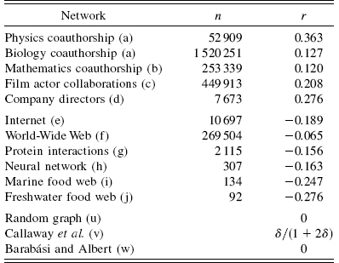
REAL NETWORKS
Social networks are assortative
Biological, technological networks are disassortative
r>0: assortative network:
Hubs tend to connect to other hubs.
r<0: disassortative network:
Hubs tend to connect to small nodes.
Network Science: Degree Correlations 2015

Slide 14
RELATIONSHIP BETWEEN r AND k_{annd}
In general case we need to know q_{k} and k_{annd}(k) to calculate r.
Assuming:
Using the constraint for ANND:
Network Science: Degree Correlations 2015

Slide 15
PROBLEM WITH THE PREVIOUS DEVIATION: k_{annd}(k)~k^{β}
Astrophysics co-authorship network
Yeast PPI
Assortative
Disassortative
Network Science: Degree Correlations 2015

Slide 16
CONNECTION WITH ANND
Assuming:
Using the constraint for ANND:
Network Science: Degree Correlations 2015

Slide 17
CONNECTION BETWEEN R AND k_{ANND}
Network Science: Degree Correlations 2015

Slide 18
DEGREE CORRELATION IN NETWORKS
0.31
-0.16
Network Science: Degree Correlations 2015

Slide 19
GENERATING NETWORK WITH GIVEN ASSORTATIVITY
We have a desired e_{jk} distribution, which also specifies p_{k}.
Generate a network with the desired degree distribution using the configuration model.
Choose two links at random from the network: (v₁,w₁) and (v₂,w₂).
Measure the degrees j₁, k₁, j₂, k₂ of nodes v₁, w₁, v₂, w₂. Replace the two selected links with two new ones (v₁,v₂) and (w₁,w₂) with probability
Repeat from step 2.
The algorithm is ergodic and satisfies detailed balance, therefore in the long time limit it samples the desired network ensemble correctly.
M. E. J. Newman, Phys. Rev. E 67, 026126 (2003)
Network Science: Degree Correlations 2015

Slide 20
GENERATING NETWORK WITH GIVEN ASSORTATIVITY
Choose two edges random from the network: (v₁,w₁) and (v₂,w₂).
Measure the degrees j₁, k₁, j₂, k₂ of vertices v₁, w₁, v₂, w₂. Replace the two selected edges with two new ones (v₁,v₂) and (w₁,w₂) with probability
1
2
3
4
Network Science: Degree Correlations 2015

Slide 21
GENERATING NETWORK WITH GIVEN ASSORTATIVITY
If we only specify r we have great degree of freedom in choosing e_{jk.}
Possible choice for disassortative case:
Where x_{k} is any normalized distribution.
This form satisfies the constraints on e_{jk}:
The r value can be easily calculated:
Assortative case:
M. E. J. Newman, Phys. Rev. E 67, 026126 (2003)
Network Science: Degree Correlations 2015

Slide 22
EXAMPLE: Erdős-Rényi
e
Network Science: Degree Correlations 2015

Slide 23
EXAMPLE: Erdős-Rényi
Network Science: Degree Correlations 2015

Slide 24
Structural cut-off
High assortativity→ high number of links between the hubs.
If we allow only one link between two nodes, we can simply run out of hubs to connect to each other to satisfy the assortativity criteria.
Number of edges between the set of
nodes with degree k and degree k’:
Maximum number of edges between
the two groups:
If we only have simple edges, we cannot have more links between the two groups, than if we connect every node with degree k to every node with degree k’ once.
There cannot be more links between the two groups, than the overall number of edges joining the nodes with degree k.
This is true even if we allow multiple edges.
M. Boguñá, R. Pastor-Satorras, A. Vespignani, EPJ B 38, 205 (2004)

Slide 25
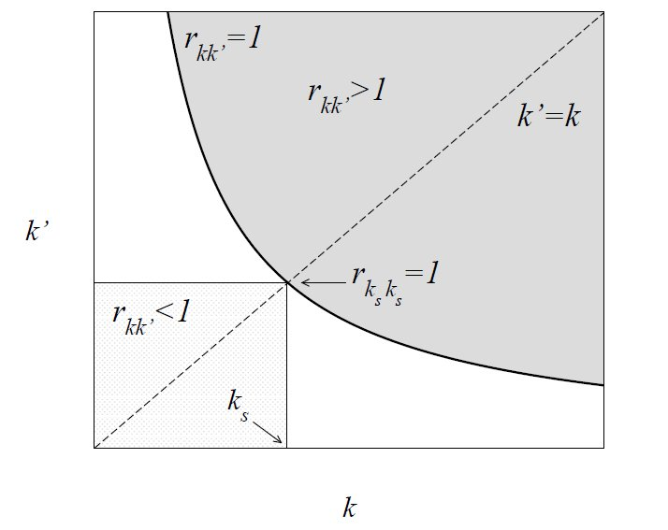
Structural cut-off
The ratio of E_{kk’} and m_{kk’} has to be ≤ 1 in the physical region!
defines the structural cut-off
M. Boguñá, R. Pastor-Satorras, A. Vespignani, EPJ B 38, 205 (2004)

Slide 26
Structural cut-off for uncorrelated networks
Uncorrelated networks:
k_{s}(N) represents a structural cutoff:
one cannot have nodes with degree larger than k_{s}(N) ,
→if there are nodes with k> k_{s}(N) we cannot find sufficient links between the highly connected nodes to maintain the neutral nature of the network.
Solution:
Introduce a structural cutoff (i.e. do not allow nodes with k> k_{s}(N)
Let the network become more dissasortative, having fewer links between hubs.

Slide 27
Example: Degree sequence introduces disassortativity
Scale-free network generated with the configuration model (N=300, L=450, γ=2.2).
The measured r=-0.19! → Dissasortative!
Red hub: 55 neighbors.
Blue hub: 46 neighbors.
Let’s calculate the expectation number of links between red node (k=55) and blue node (k=46) for uncorrelated networks!
In order for the network to be neutral, we need 2.8 links between these two hubs.

Slide 28
The largest nodes have k_{annd}< <k_{annd}>

Slide 29
The effect is particularly clear for N=10,000:
The red curves are those of interest to us: one can see that a clear dissasortativity property is visible in this case.

Slide 30
Natural cutoffs in scale-free networks
All real networks are finite → let us explore its consequences.
→ We have an expected maximum degree, K_{max}
Estimating K_{max}
Why: the probability to have a node larger than K_{max} should not exceed the prob. to have one node, i.e. 1/N fraction of all nodes
Natural cutoff:

Slide 31
Structural cut-off for uncorrelated networks
Structural cutoff:
Natural cut-off:
γ=3: k_{s}(N) and k_{max}(N) scale the same way, i.e. ~N^{1/2}.
The size of the largest hub is above the structural cutoff, which means that it cannot have enough links to the other hubs to maintain its neutral status.
→ disassortative mixing
γ<3:
→a randomly wired network with γ<3 will be
dissasortative
Or will have to have a cutoff at k_{s}(N)< k_{max}(N)
Notes:
We are interested only in SF networks, as ER network do not have hubs, and thus the problem is less acute.

Slide 32
Example: introducing a structural cut-off
Scale-free network generated with the configuration model (N=300, L=450, γ=2.2) with structural cut-off ~ N^{½}.
r=0.005 → neutral
Red hub: 12 neighbors.
Blue hubs: 11 neighbors.
Again we can calculate the expectation number of edges between the hubs.

Slide 33
The largest nodes have k_{annd}~ <k_{annd}>

Slide 34
Once again, the phenomenon is particularly clear for N=10,000
(and averaged over 100 independent runs):
The BLUE curves are those of interest to us: one can see that cutoff in p_{k} removes completely the dissasortativity observed earlier.

Slide 35
Summary
No multiple edges.
Existence of hubs.
Random connection of nodes lead to disassortativity.
For the uncorrelated case the structural cut-off is:
This is true for networks that follow
Network models: Either we introduce an artificial cut-off in the network, or we have to keep in mind that even though we are randomly connecting the stubs, by imposing constraints on the edges non-trivial correlations will emerge.
Real-world networks: The question we asked when introducing degree-degree correlations was, is the degree distribution on its own sufficient to describe the structure of a network? In other words, are the nodes randomly connected?
In the case of assortative networks the correlations cannot be due to the structural cut-off since the effect of the hubs is opposite. So there has to be some process during the evolution of the network that effects the correlations and drives the network into an assortative state.
In the disassortative case we can say that the lack of structural cut-off can be a reason for certain amount of disassortativity, and further investigation is needed to determine whether it is the only reason or just one of the effects.

